Slide 1

Computer Engineering Department
A.P. Shah Institute of Technology
G.B.Road,Kasarvadavli, Thane(W), Mumbai-400615
UNIVERSITY OF MUMBAI
Academic Year 2019-2020

Slide 2
A Project Report on
Artificial Teaching Assistant
Submitted in partial fulfillment of the degree of
Bachelor of Engineering(Sem-7)
in
Computer Engineering
By
Nirish Samant(16102008) Akshay Sumbhe(16102062)
Tarakeshwarnath Sahani(16102033)
Under the Guidance of
Prof.Sachin Takmare

Slide 3
1.Project Conception and Initiation

Slide 4
1.1 Abstract
It is an Artificial Teaching Assistant that has been developed with main aim to assist students in their learning process by ensuring fast and efficiently search of documents and learning materials.
It is designed to work for english spoken language although it might work on some better than other depending on the nature of the language, the structure, grammar and semantics.
The method uses this metric to derive context from data and then queries the data source looking for the best match.

Slide 5
1.2 Objectives
As educational AI progresses and becomes more sophisticated, it’s essential to include teachers in the process. In an ideal world, teachers and AI will create an immersive learning experience for students, together.
To provide flexibility to an students to ask questions until they have a full understanding of the concepts without taking up teacher time.
To fill the gaps for slower learning students.

Slide 6
1.3 Literature Review
We refered various books and papers to understand various concepts related to Artificial Intelligence , Image Processing ,
Signal Processing , Machine Learning etc
Some of the books are :
1) Artificial Intelligence A Modern Approach , Stuart J. Russell and Peter Norvig
2) Artificial Intelligence and Intelligent Systems , N.P.Padhy
3) Artificial Intelligence , Elaine Rich and Kevin Knight
4) Introduction to soft computing , Samir Roy and Chakraborty
5) Principles of Soft Computing , S.N.Sivanandam, S.N.Deepa
6) Neural Networks, Fuzzy Logic and Genetic Algorithms , S.Rajasekaran and G.A. Pai
7) Fuzzy Set Theory and its Applications , Zimmermann
8) Digital Image Processing by Rafel C. Gonzalez and Richard E. Woods
9) Digital Image Processing by S. Sridhar
10) Digital Signal Processing John G. Proakis, Dimitris and G.Manolakis
11) Digital Signal Processing , A. Anand Kumar
12) Management Information Systems , Kelly Rainer, Brad Prince

Slide 7
1.5 Scope
The performance requirements of the application have continuously increased the computing power of implementation platforms, especially when they are executed under real time constraints.
The real time applications may consist of different standards,or different algorithms used at different stages of the processing chain.
The computing paradigm using reconfigurable architectures promises an itermediate trade-off between flexibility and performance.

Slide 8
1.6 Technology stack
Python
Python is an interpreted, high-level, general-purpose programming language.Its language constructs and object-oriented approach aim to help programmers write clear, logical code for small and large-scale projects.
Open CV
OpenCV (Open source computer vision) is a library of programming functions mainly aimed at real time computer vision.The library is cross-platform and free for use under the open source BSD license.

Slide 9
1.7 Benefits for environment & Society
Reduced Carbon Footprint
Access to Documents from Everywhere
Keeps Things Simple
Reduced Costs
Increased output and productivity
Increased quality
Reliability

Slide 10
2. Project Design

Slide 11
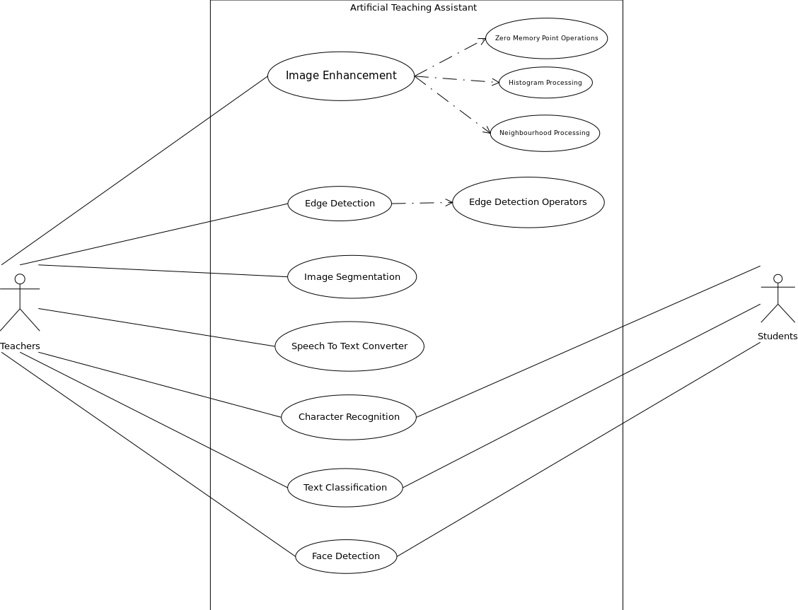
Use Case Diagramn

Slide 12
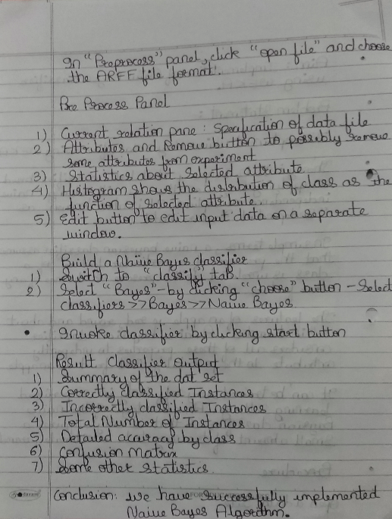
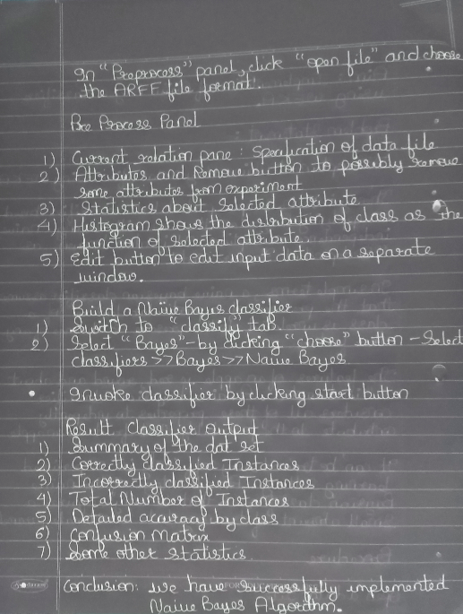
Digital Negative / Inversion

Slide 13
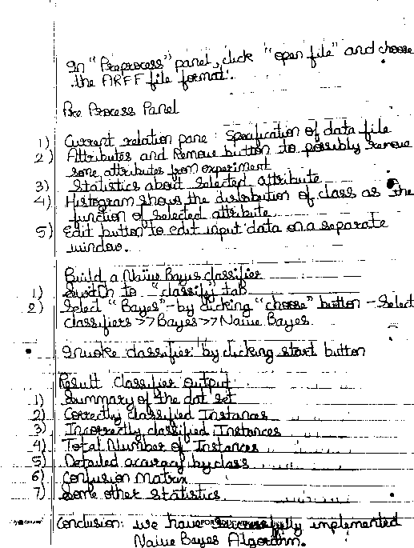
Thresholding

Slide 14
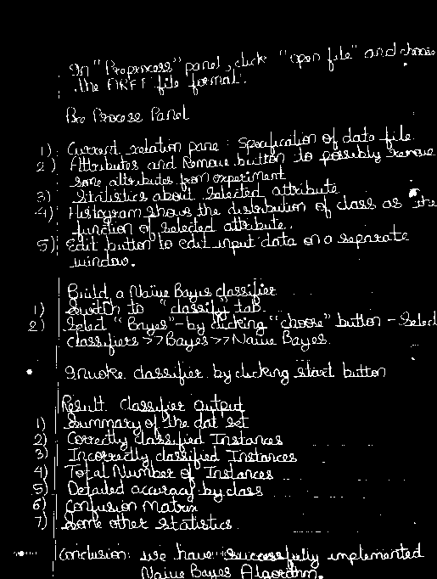
Intensity Level Slicing without Background

Slide 15
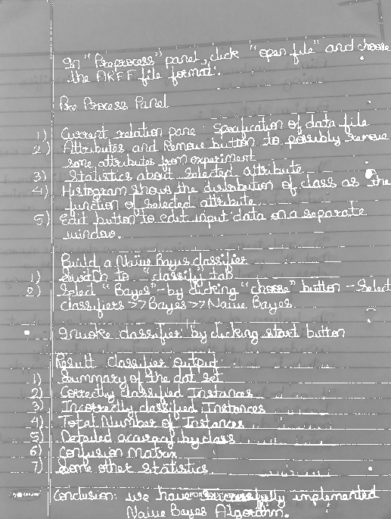
Intensity Level Slicing with Background

Slide 16





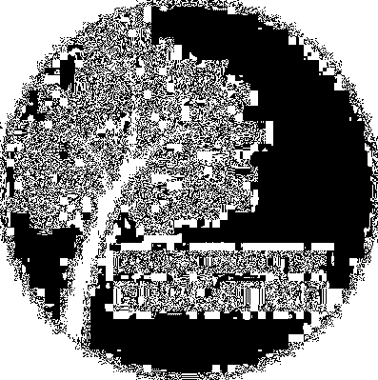



Bit Plane Slicing

Slide 17
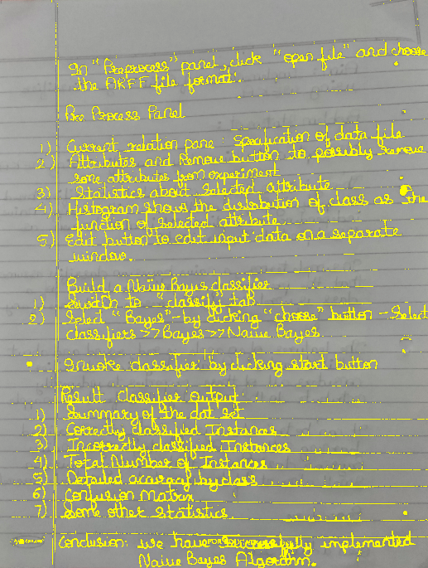
Image Text Colouration

Slide 18
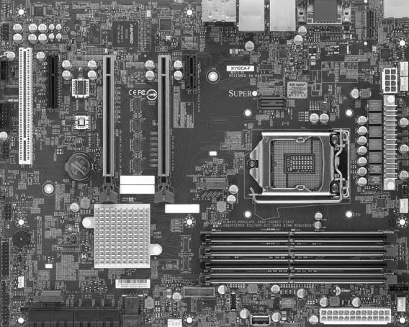
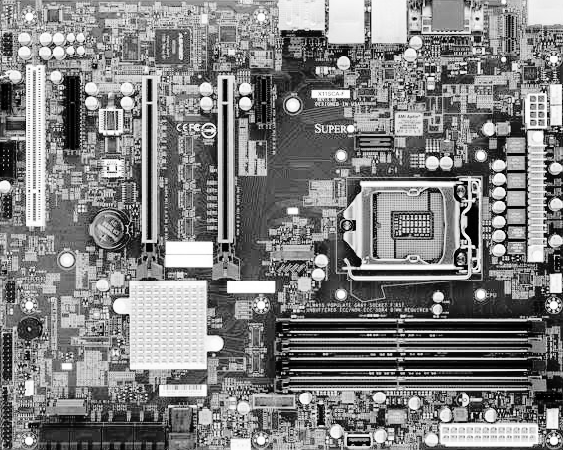
Histogram Equalization

Slide 19
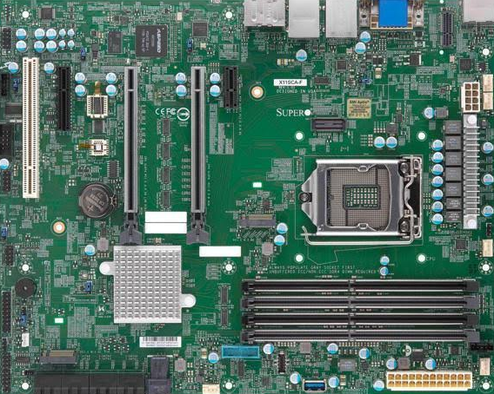
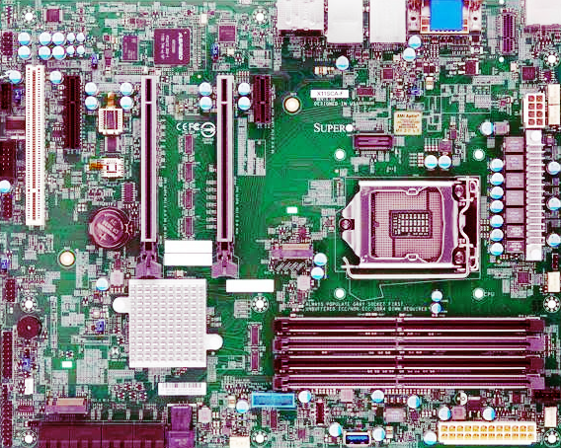
Histogram Equalization

Slide 20
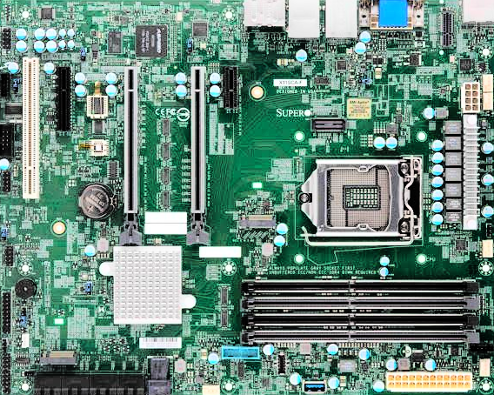
Histogram Equalization

Slide 21
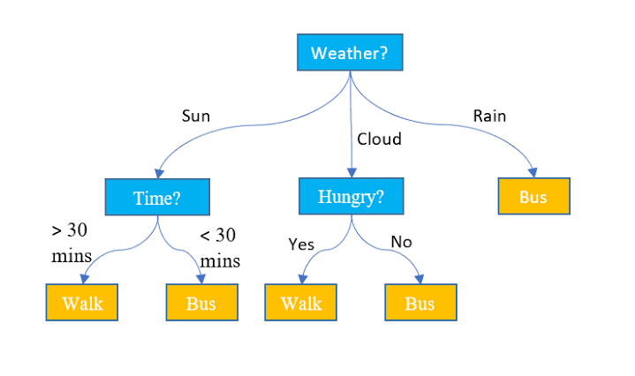

Image Smoothing

Slide 22
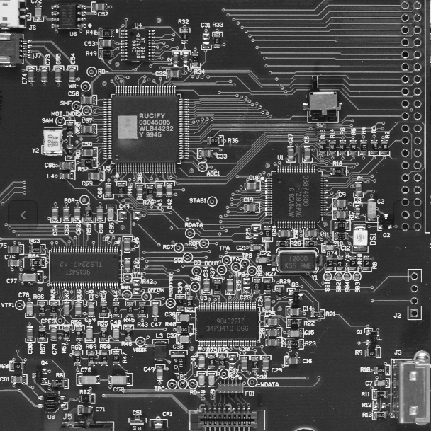
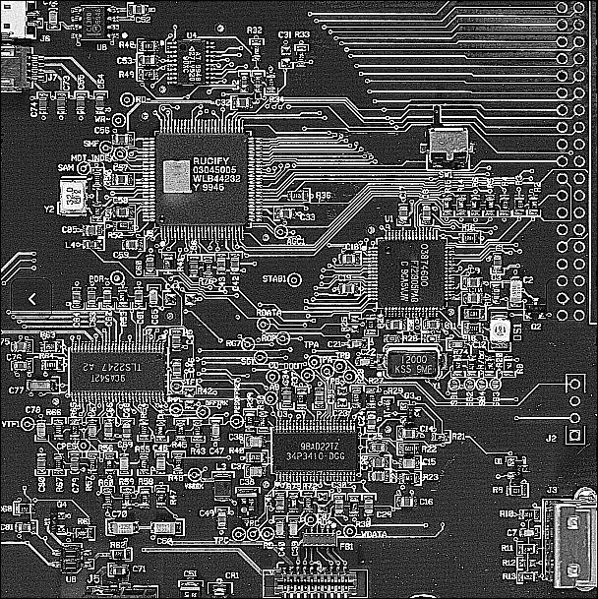
Image Sharpening

Slide 23
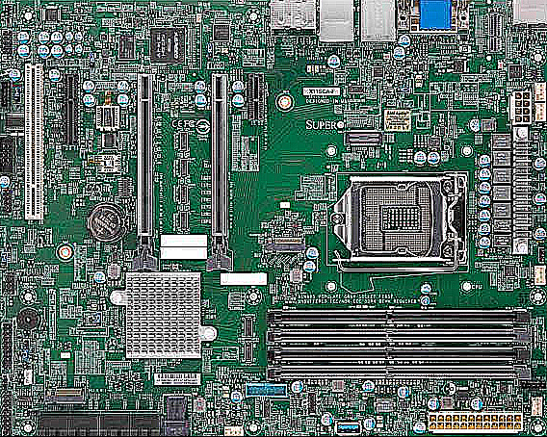
Image Sharpening

Slide 24
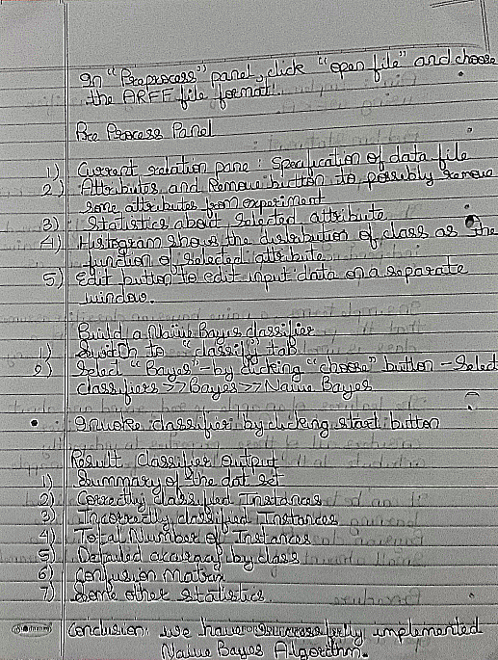
Image Sharpening

Slide 25
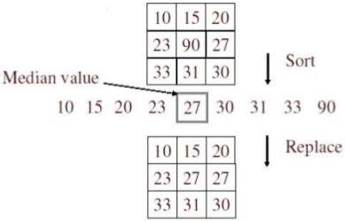
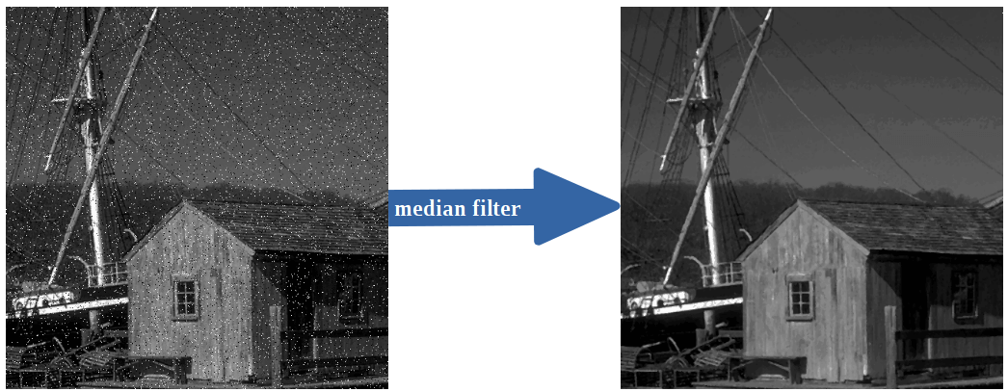
Median Filter

Slide 26
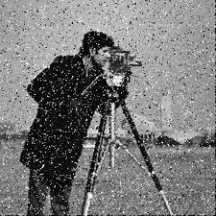

Median Filter

Slide 27
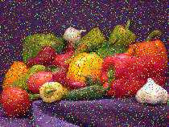
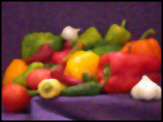
Median Filter

Slide 28
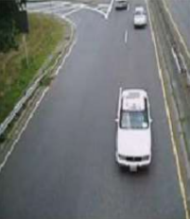
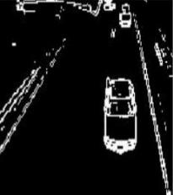
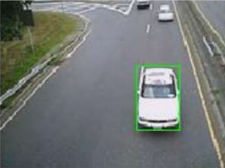
Edge Detection

Slide 29
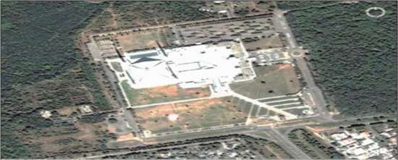
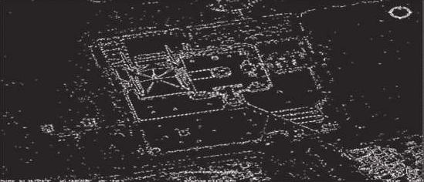
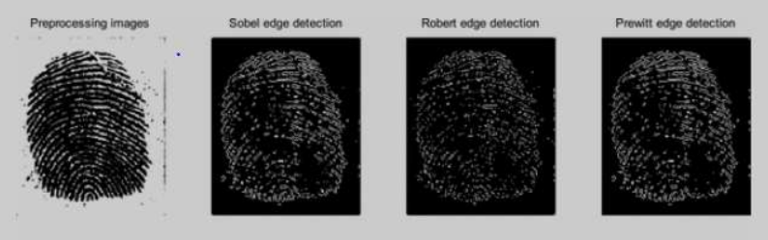
Edge Detection

Slide 30
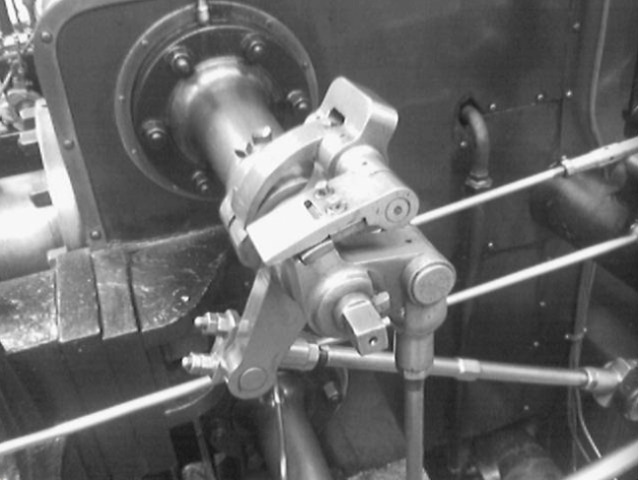
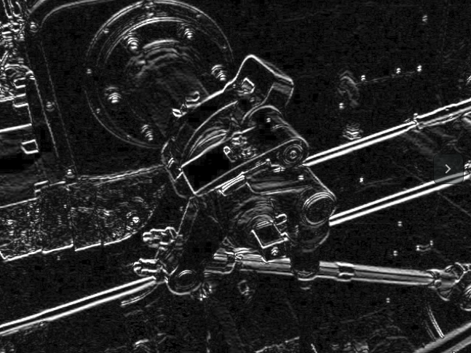
Edge Detection

Slide 31
2.7 References
1) Digital Image Processing by Rafel C. Gonzalez and Richard E. Woods
2) Digital Image Processing”by S. Sridhar
3) Digital Signal Processing by John G. Proakis, Dimitris and G.Manolakis
4) Digital Signal Processing by A. Anand Kumar
5) Tom M.Mitchell “Machine Learning” McGraw Hill
6) Stephen Marsland, “Machine Learning An Algorithmic Perspective” CRC Press
7) Artificial Intelligence A Modern Approach , Stuart J. Russell and Peter Norvig
8) Artificial Intelligence and Intelligent Systems , N.P.Padhy
9) Artificial Intelligence , Elaine Rich and Kevin Knight
10) Neural Networks, Fuzzy Logic and Genetic Algorithms , S.Rajasekaran and G.A. Pai
11) Fuzzy Set Theory and its Applications , Zimmermann
12) Introduction to soft computing , Samir Roy and Chakraborty
13) Principles of Soft Computing , S.N.Sivanandam, S.N.Deepa

Slide 32
3.Planning for next semester

Slide 33
Planning
Implement the remaining functions in the software.

Slide 34
Thank You

